Slide 1

The Machine Learning Process
How do I change display options in pandas?
Reza Dibaj

Slide 2
Changing display options in pandas
Is there a simple way to format large numbers with commas (1,000,000) when printing or showing on the graph?
In general, how do we change display options in pandas?

Slide 3
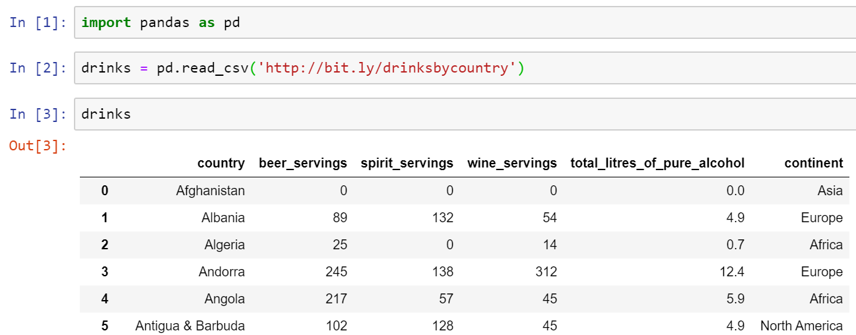
Changing display options in pandas
Let’s pull up the following dataset…. This time by calling the DF name, it shows the first and the last 30 rows of the DF as follows:
What if I want to show all of the rows?

Slide 4
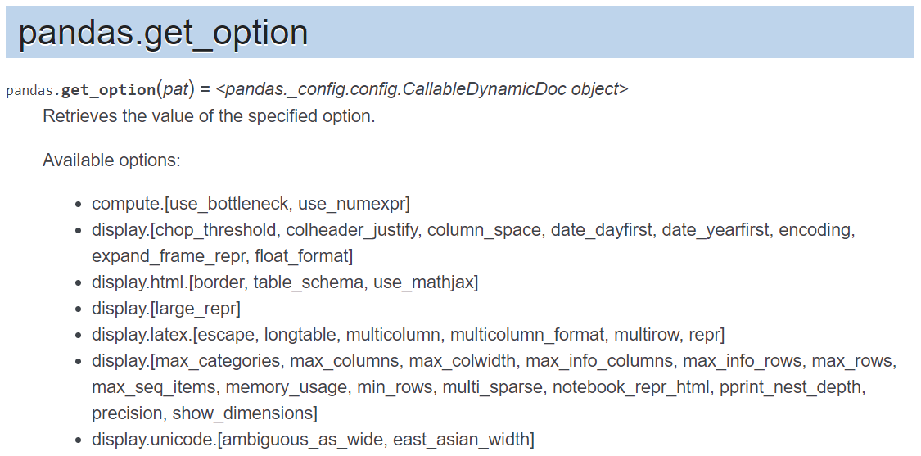
Changing display options in pandas
For pandas display options we can go and find out pandas.get_option:
Notes:
https://pandas.pydata.org/pandas-docs/stable/reference/api/pandas.get_option.html

Slide 5
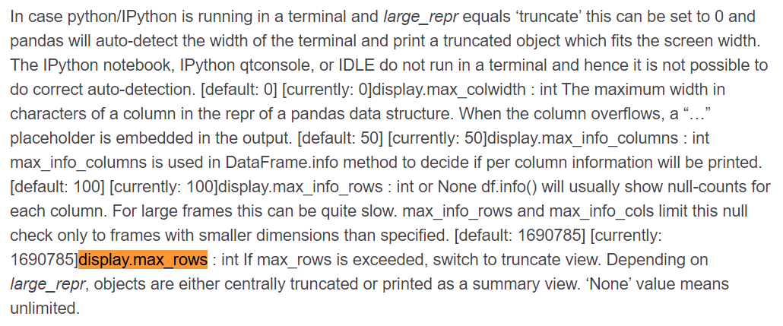
Changing display options in pandas
We need to search for display.max_rows:
Notes:
https://pandas.pydata.org/pandas-docs/stable/reference/api/pandas.get_option.html

Slide 6
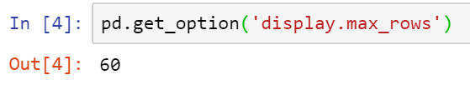

Changing display options in pandas
First, let’s see the current status:
And now, we change its value as follows, which means show all rows:
Notes:
pd.get_option('display.max_rows’)
pd.set_option('display.max_rows', None)

Slide 7
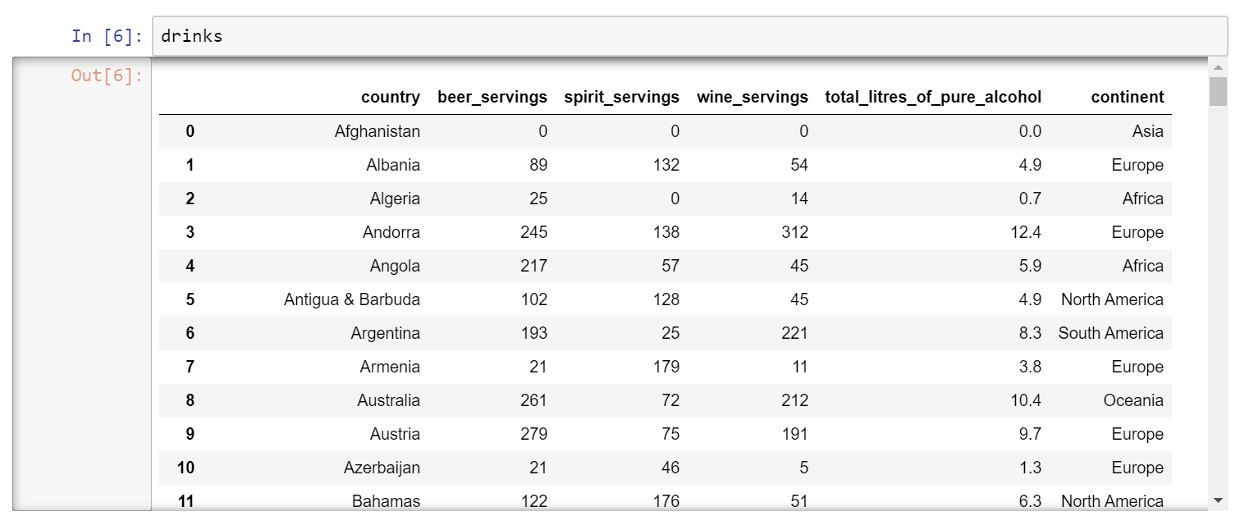
Changing display options in pandas
So, if we display drinks once again, it will display all the rows as follows:
Notes:
drinks

Slide 8

Changing display options in pandas
How can we set it back to the default value?

Slide 9
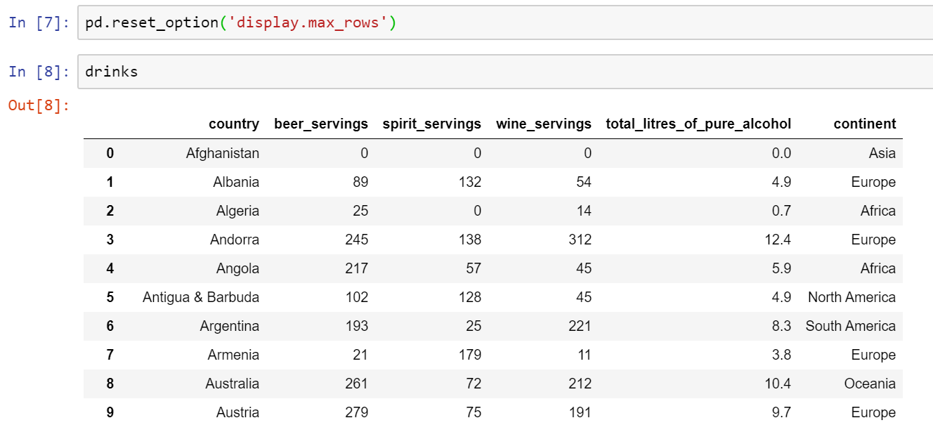
Changing display options in pandas
What if you want to reset it back to the original setting?
Notes:
pd.reset_option('display.max_rows’)
drinks

Slide 10
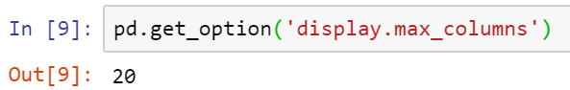
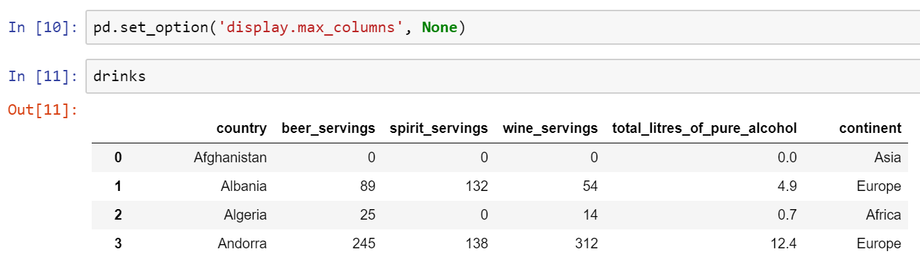

Changing display options in pandas
What if we have a DF that contains a lot of columns?
Then you can set or reset the number of columns as we did for the number of rows:
Notes:
pd.get_option('display.max_columns')
pd.set_option('display.max_columns', None)
Drinks
pd.reset_option('display.max_columns')

Slide 11
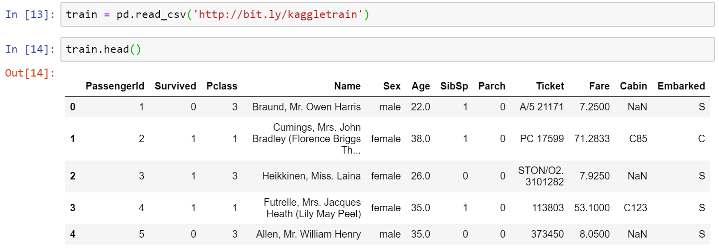
Changing display options in pandas
Let’s see two more options….
How can we see these hidden characters?
Notes:
train = pd.read_csv('http://bit.ly/kaggletrain’)
train.head()

Slide 12
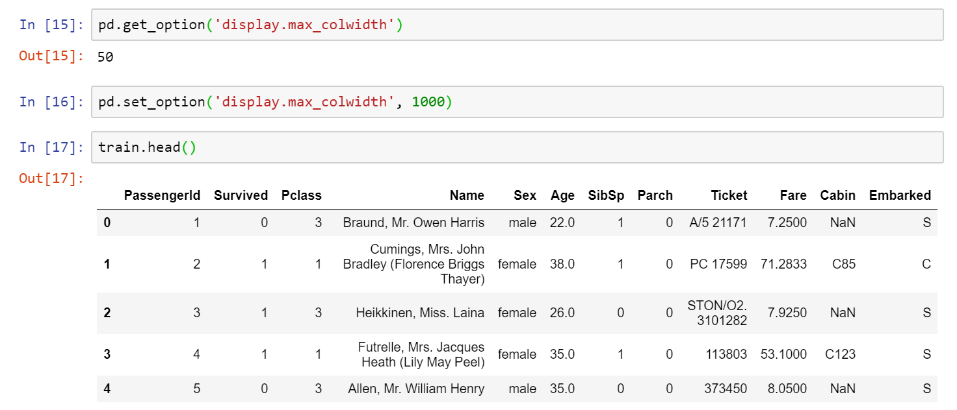
Changing display options in pandas
Here is how we can change the default:
Notes:
pd.get_option('display.max_colwidth’)
pd.set_option('display.max_colwidth', 1000)
train.head()

Slide 13
Changing display options in pandas
Let’s look at the Fare column and show only 2 decimal points instead of 4 decimal points:

Slide 14
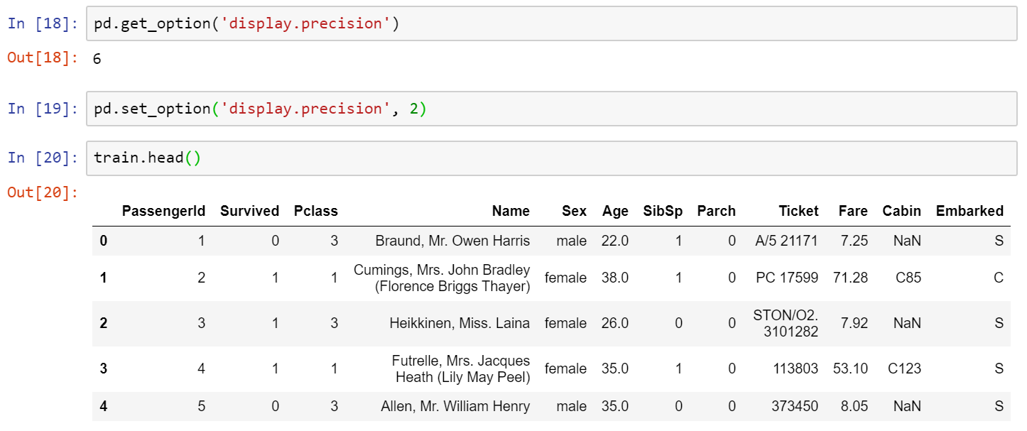

Changing display options in pandas
Here is how we change the default….
It does not impact the underlying data!
Notes:
pd.get_option('display.precision’)
pd.set_option('display.precision', 2)
train.head()

Slide 15
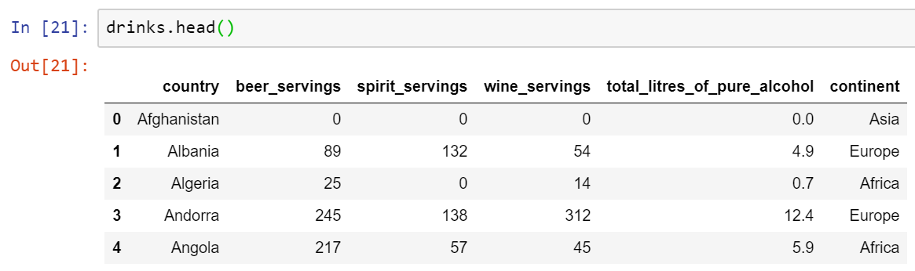
Changing display options in pandas
How about formatting our displayed data, with comma separated and so on….
Notes:
drinks.head()

Slide 16
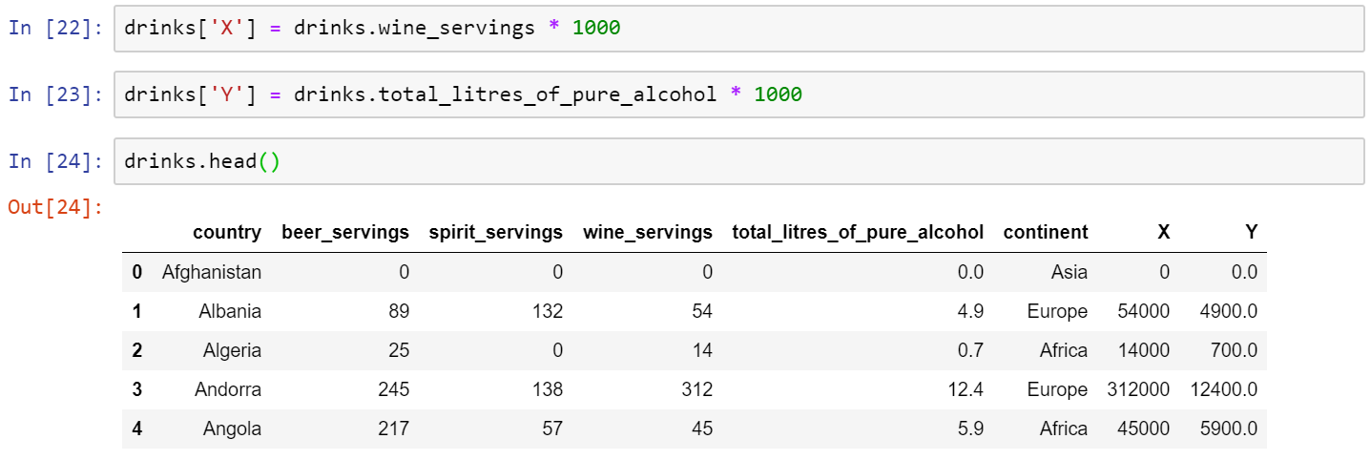
Changing display options in pandas
We generate two dummy columns with more number of digits to work on…
Notes:
drinks['X'] = drinks.wine_servings * 1000
drinks['Y'] = drinks.total_litres_of_pure_alcohol * 1000
drinks.head()

Slide 17
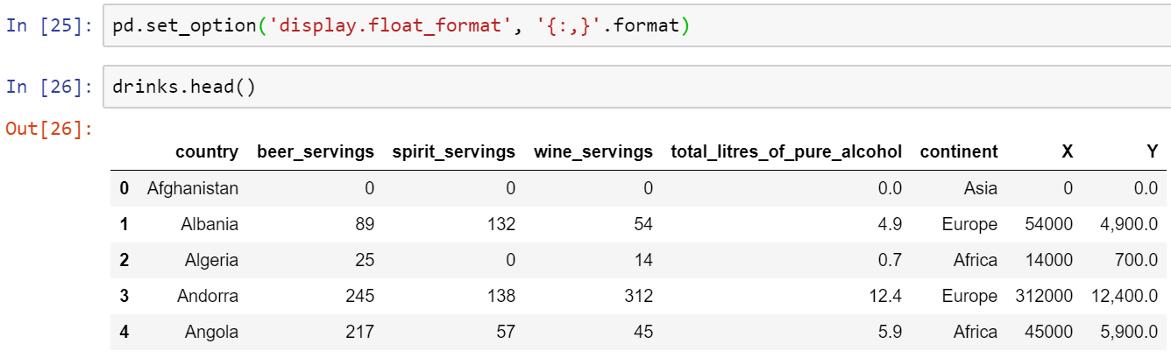
Changing display options in pandas
Let’s see how we can format our numerical columns:
We have passed a Python format string, which means use commas as thousand separators.
The question is why Y was changed, but X didn’t?
Why?
Notes:
pd.set_option('display.float_format', '{:,}'.format)
drinks.head()

Slide 18
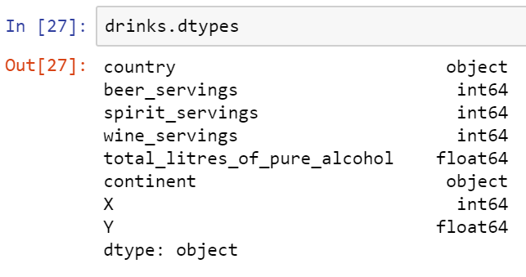
Changing display options in pandas
Here is the answer…. Can you explain to your team members?
Notes:
drinks.dtypes

Slide 19
Changing display options in pandas
Can you find any way to change the format of integer numbers’ display?
Nothing is in the next slid :D

Slide 20

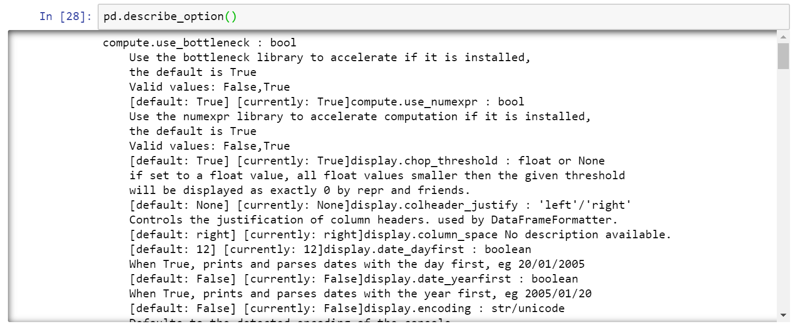
Bonus Tip
How can you read pandas options without using the internet?
Notes:
pd.describe_option()

Slide 21
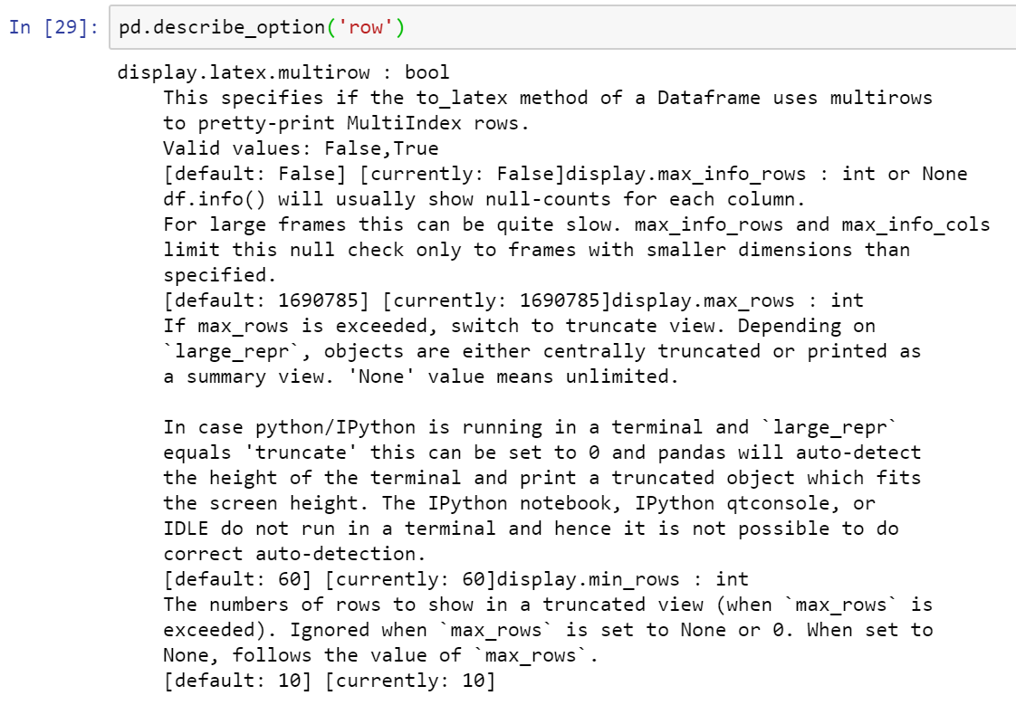
Bonus Tip
And when you know the part of the option’s name you can simply use the following approach:
Notes:
pd.describe_option('row')

Slide 22
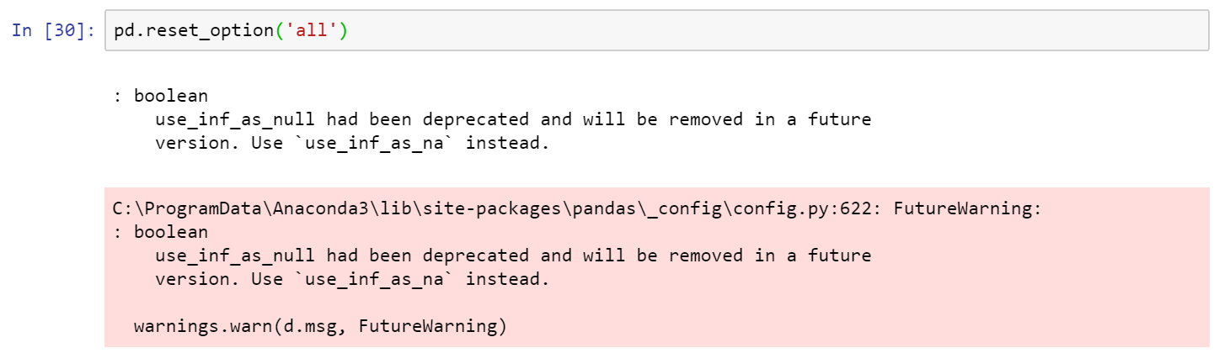
Bonus Tip
The other bonus is how we can reset all the options that we have already changed? …. As simple as this….
And please ignore the warning. This warning is really just a warning :)
Notes:
pd.reset_option('all')

Slide 23

Thank you
Question?
To be
Not to be
Notes:
https://stackoverflow.com/questions/29663252/format-pandas-integers-for-display

